Slide 1

Supply Chain Performance Analysis
A Power BI Dashboard for Data-Driven Decision Making
Presented by: SIDDARTH GR

Slide 2
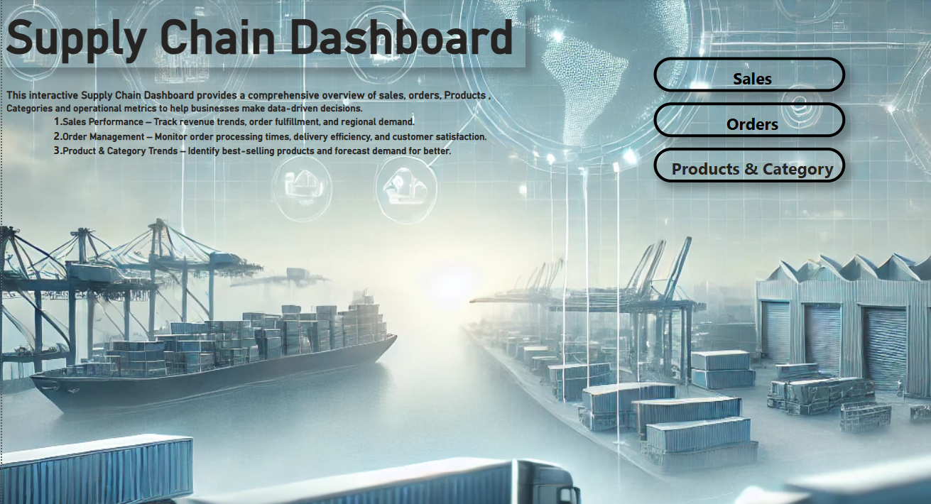

Slide 3
Problem Statement & Objective
Problem Statement:
DataCo Global operates in a competitive market, managing Clothing, Sports, and Electronic Supplies. Efficient supply chain management is essential for timely deliveries, cost optimization, and customer satisfaction. However, challenges like late deliveries, inventory inefficiencies, demand fluctuations, and operational bottlenecks impact profitability and customer retention, necessitating a data-driven approach to optimization.
Objective:
Analyze supply chain performance using key metrics.
Identify inefficiencies in supply chain.
Provide actionable insights using Power BI.

Slide 4
Approaches Used and Data Source
Approaches Used:
Data Cleaning & Preprocessing
Data Modeling
DAX Calculations
Visualization & Dashboard Creation
Data Source:
It was downloaded from an secondary open-source named Kaggle.

Slide 5
DAX Calculations
Key DAX Calculations on Orders table :
Total Sales: SUM(Sales[Amount])
Total Profit = SUM([Order Profit Per Order])
Profit Margin = [Order Profit Per Order] / [Order Item Total]
Total_Items_Ordered_by_state = SUM('OrderItems Table'[Order Item Total])
Total_Order_Count = DISTINCTCOUNT('Orders-table'[Order Id])
Total_Quantity_Sold = SUM('OrderItems Table'[Order Item Total])
Total_Sales_By_Items = SUM('OrderItems Table'[Order Item Total])
Key DAX Calculations on Products table :
Average_Discount_Rate = AVERAGE('OrderItems Table'[Order Item Product Price])
Average_Selling_Price = AVERAGE('OrderItems Table'[Order Item Product Price])
Profit_by_product = SUM('OrderItems Table'[Order Item Total])
sales_by_Product = SUM('OrderItems Table'[Order Item Total])

Slide 6
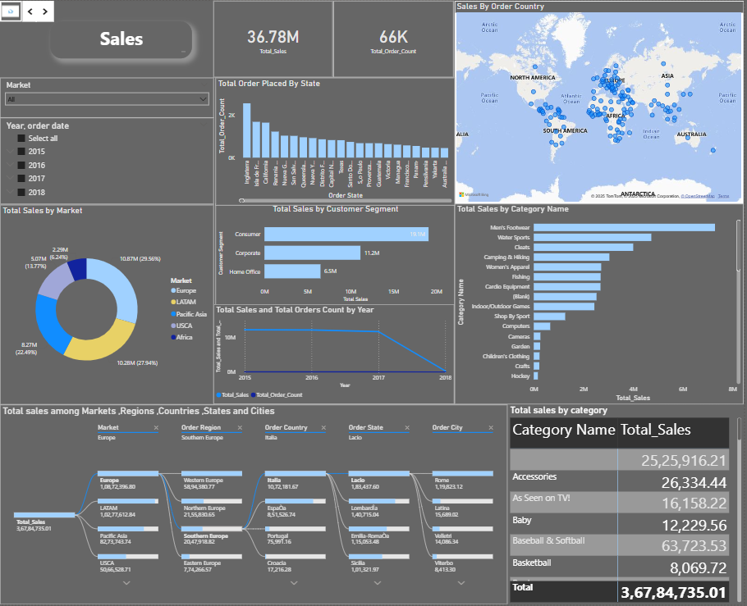
DAX Calculations
Key DAX Calculations on Categories table:
Profit_by_catgory = SUM('OrderItems Table'[Order Profit Per Order])
Quantity_sold_by_category = SUM('OrderItems Table'[Order Item Quantity])
sales_by_category = SUM('OrderItems Table'[Order Item Total])

Slide 7
Editing & Modifications
Data Cleaning & Transformations:
Removed missing values and duplicates
Standardized date and currency formats
Merged tables using Power Query
Data Modeling Adjustments:
Established one-to-many relationships between Orders, Products etc..
Added calculated columns for performance tracking
Visualization & Dashboard Enhancements:
Used bar charts, line graphs, and KPI cards
Applied filters and slicers for interactivity
Created drill-through pages for detailed analysis

Slide 8
Business Insights
Key Insights:
Order Fulfillment Efficiency: 85% fulfillment rate, optimization needed.
Inventory Management: Excess stock and stockouts identified. Recommendation: Adjust reorder levels & improve turnover.
Supplier Performance: Lead time varies, impacting operations. Recommendation: Identify reliable suppliers.
Revenue & Sales Trends: Peak months & weak product categories noted. Recommendation: Adjust marketing & stocking strategies.

Slide 9
Conclusions
Data-driven decision-making enhances supply chain efficiency.
Power BI insights help reduce costs & improve performance.
Future scope: Use predictive analytics for further optimization.

